Slide 1
Keras的序贯模型
fastai中文社区 杨杰

Slide 2
目录
序贯模型介绍
搭建神经网络的步骤
MNIST识别手写数字

Slide 3
序贯模型
序贯模型是多个网络层的线性堆叠
通过向Sequential模型传递一个网络层列表创建Sequential 模型
from keras.models import Sequential
from keras.layers import Dense, Activation
model = Sequential([
Dense(32, input_shape=(784,)),
Activation('relu'),
Dense(10),
Activation('softmax'),
])
或者简单地通过.add()方法添加网络层
model = Sequential()
model.add(Dense(32, input_dim=784))
model.add(Activation('relu'))

Slide 4
用Keras搭建神经网络的步骤

Slide 5
1.设置环境
Anaconda
TensorFlow & Theano
Keras

Slide 6
2. 导入库和模块
# numpy
import numpy as np
np.random.seed(123) # for reproducibility
#keras模型模块
from keras.models import Sequential
#keras核心层
from keras.layers import Dense, Dropout, Activation, Flatten
#keras CNN层
from keras.layers import Convolution2D, MaxPooling2D
# Utilities
from keras.utils import np_utils

Slide 7
3. 加载数据
# 加载MNIST数据
from keras.datasets import mnist
# Load pre-shuffled MNIST data into train and test sets
(X_train, y_train), (X_test, y_test) = mnist.load_data()
#查看数据集轮廓
print X_train.shape
# (60000, 28, 28)
训练集有60000个样本，图片是28*28

Slide 8
4. 预处理输入数据
# 转换数据类型和正态化数值
X_train = X_train.astype('float32')
X_test = X_test.astype('float32')
X_train /= 255
X_test /= 255

Slide 9
5. 预处理类标签
# Convert 1-dimensional class arrays to 10-dimensional class matrices
Y_train = np_utils.to_categorical(y_train, 10)
Y_test = np_utils.to_categorical(y_test, 10)

Slide 10
6. 定义模型框架
# 序贯模型声明
model = Sequential()
# CNN输入层
model.add(Convolution2D(32, 3, 3, activation='relu', input_shape=(1,28,28)))
print model.output_shape
# (None, 32, 26, 26)
# 更多层
model.add(Convolution2D(32, 3, 3, activation='relu'))
model.add(MaxPooling2D(pool_size=(2,2)))
model.add(Dropout(0.25))
# 全连接层和输出层
model.add(Flatten())
model.add(Dense(128, activation='relu'))
model.add(Dropout(0.5))
model.add(Dense(10, activation='softmax'))

Slide 11
7. 编译模型
# 编译模型
model.compile(loss='categorical_crossentropy',
optimizer='adam',
metrics=['accuracy'])

Slide 12
8. 训练模型
# 训练模型
model.fit(X_train, Y_train,
batch_size=32, nb_epoch=10, verbose=1)
# Epoch 1/10
# 7744/60000 [==>...........................] - ETA: 96s - loss: 0.5806 - acc: 0.

Slide 13
9. 在测试数据上评估模型
# 评估模型
score = model.evaluate(X_test, Y_test, verbose=0)

Slide 14
实例：识别手写数字

Slide 15
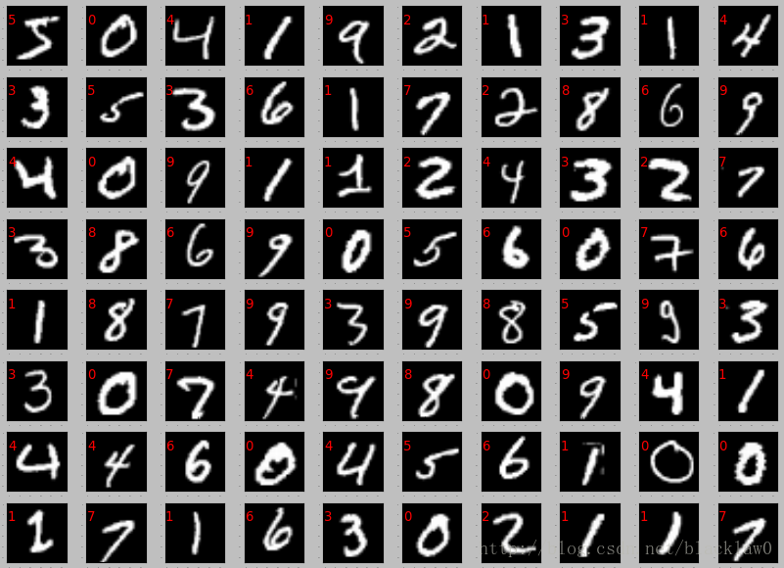
MNIST手写数字识别
http://yann.lecun.com/exdb/mnist/
MNIST数据集包括60000个训练数据、
10000个测试数据
每个MNIST图像是灰度的，为28*28 pixels

Slide 16
V1简单模型
model = Sequential()
model.add(Dense(NB_CLASSES, input_shape=(RESHAPED,)))
model.add(Activation('softmax'))
训练集 92.36%
验证集 92.27%
测试集 92.22%

Slide 17
V2 增加隐藏层
model = Sequential()
model.add(Dense(N_HIDDEN, input_shape=(RESHAPED,)))
model.add(Activation('relu'))
model.add(Dense(N_HIDDEN))
model.add(Activation('relu'))
model.add(Dense(NB_CLASSES))
model.add(Activation('softmax'))
训练集 94.50%
验证集 94.63%
测试集 94.41%

Slide 18
V3 增加dropout
model = Sequential()
model.add(Dense(N_HIDDEN, input_shape=(RESHAPED,)))
model.add(Activation('relu'))
model.add(Dropout(DROPOUT))
model.add(Dense(N_HIDDEN))
model.add(Activation('relu'))
model.add(Dropout(DROPOUT))
model.add(Dense(NB_CLASSES))
model.add(Activation('softmax'))
20 epochs
训练集 91.54%
验证集 94.48%
测试集 94.25%
250 epochs
训练集 98.10%
验证集 97.73%
测试集 97.70%

Slide 19
V4 优化器RMSprop
OPTIMIZER = RMSprop() # optimizer
训练集 97.97%
验证集 97.59%
测试集 97.84%

Slide 20
V5 优化器Adam
OPTIMIZER = Adam() # optimizer
训练集 98.28%
验证集 98.03%
测试集 97.93%

Slide 21
LeNet
model = Sequential()
# CONV => RELU => POOL
model.add(Conv2D(20, kernel_size=5, padding="same",
input_shape=input_shape))
model.add(Activation("relu"))
model.add(MaxPooling2D(pool_size=(2, 2), strides=(2, 2)))
# CONV => RELU => POOL
model.add(Conv2D(50, kernel_size=5, padding="same"))
model.add(Activation("relu"))
model.add(MaxPooling2D(pool_size=(2, 2), strides=(2, 2)))
# Flatten => RELU layers
model.add(Flatten())
model.add(Dense(500))
model.add(Activation("relu"))
# a softmax classifier
model.add(Dense(classes))
model.add(Activation("softmax"))
训练集 99.89%
验证集 99.11%
测试集 99.08%

Slide 28

Thanks!
Contact:
yangjie@fastai.com.cn

